Slide 1
Utopie concrete per l’Europa di oggi
Philippe Van Parijs Brescia, 17 Maggio 2018

Slide 2
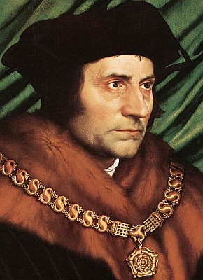
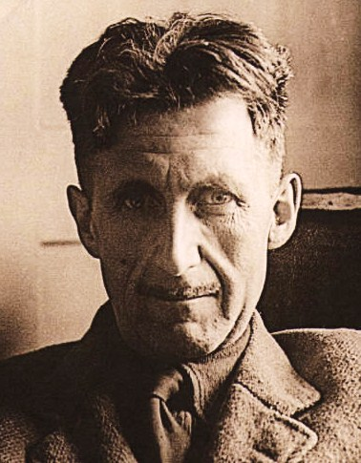
L’utopia come genere letterario
1515 Thomas More,
De Optima Republicae Statu, deque Nova Insula Utopia
1602 Tommaso Campanella, La Città del Sole
1726 Jonathan Swift, Gulliver’s Travels
1770 Louis-Sébastien Mercier, L’An 2440 : un rêve s’il en fut jamais
1890 William Morris, News from Nowhere
1932 Aldous Huxley, Brave New World
1949 George Orwell, 1984

Slide 3
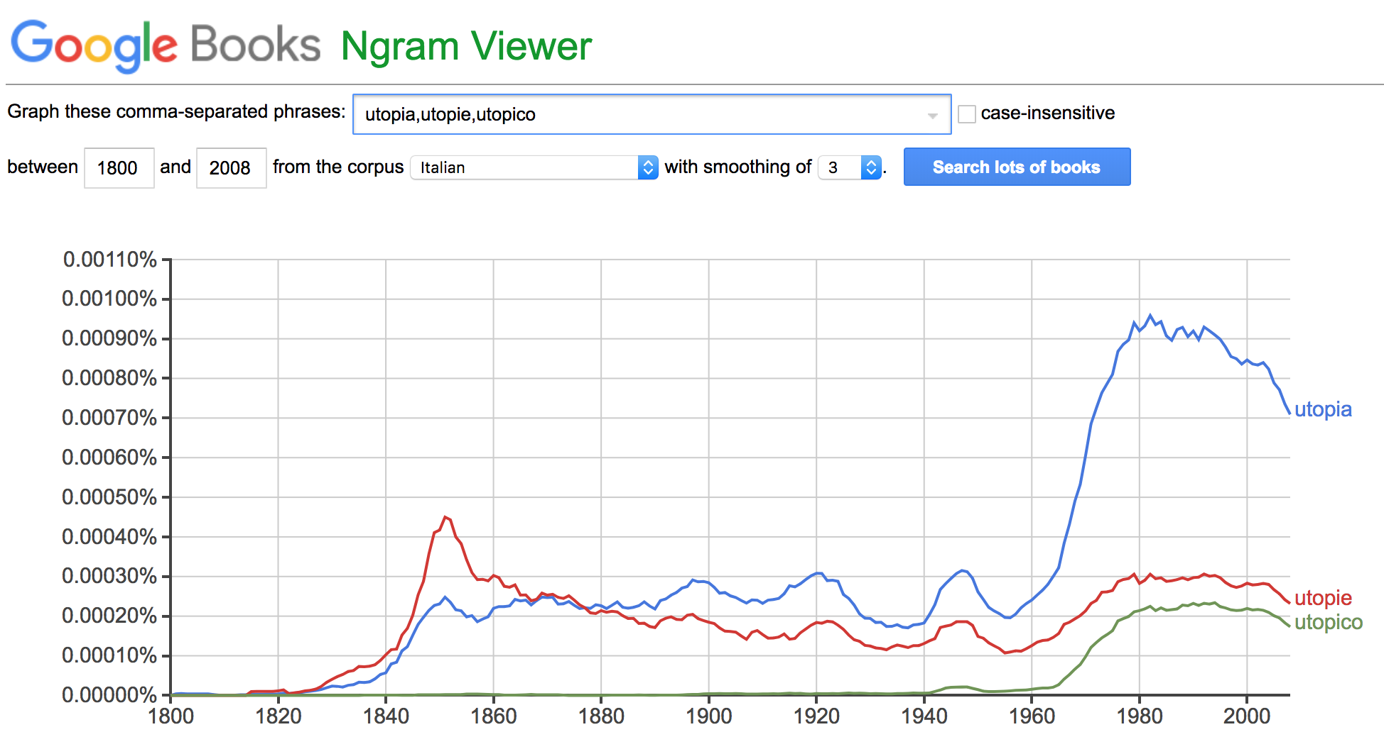
L’utopia come nome comune
Google NGram

Slide 4
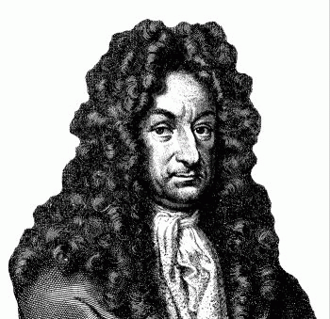
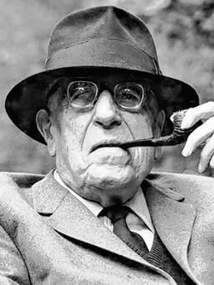
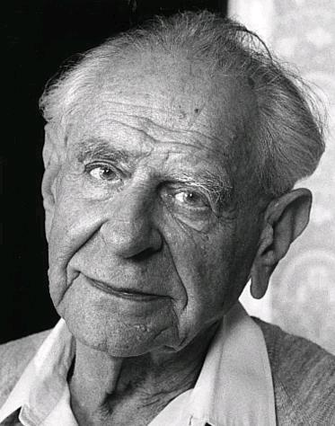
Oziosa, fruttuosa, pericolosa ?
1710: Gottfried Wilhelm LEIBNIZ, Essais de théodicée.
1880. Friedrich ENGELS, Socialisme utopique
et socialisme scientifique
1918. Ernst BLOCH, Geist der Utopie
1929. Karl MANNHEIM, Ideologie und Utopie
1945. Karl POPPER, The Open Society and its Enemies

Slide 5
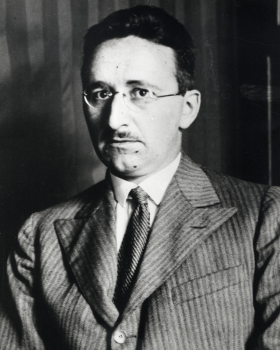
Friedrich Hayek
The Road to Serfdom, 1944.
“… democratic socialism, the great utopia of the last few generations, is not only unachievable but to strive for it produces something so utterly different that few of those who now wish it would be prepared to accept the consequences…”

Slide 6
Friedrich Hayek
« The intellectuals and socialism », 1949.
“The main lesson which the true liberal must learn from the success of the socialists is that it was their courage to be Utopian which gained them the support of the intellectuals and thereby an influence on public opinion which is daily making possible what only recently seemed utterly remote.”
“We must make the building of a free society once more an intellectual adventure, a deed of courage. What we lack is a liberal Utopia, […] which is not too severely practical and which does not confine itself to what appears today as politically possible.”

Slide 8
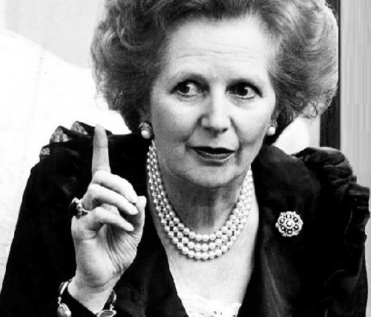
Margaret Thatcher
Statecraft. Strategies for a Changing World, 2002.
“‘Europe’ is the result of plans. It is, in fact, a classic utopian project, a monument to the vanity of intellectuals, a programme whose inevitable destiny is failure: only the scale of the final damage done is in doubt.”
“It is no surprise to me that the strongest proponents of Euro-federalism today often first cut their political teeth in the infantile utopianism, tinged with revolutionary violence, of the late 1960s and the 1970s.”

Slide 9
La trappola di Hayek e il destino dell’Europa
“The economic conditions of interstate federalism” (1939)
Intervenzionisme statale
• economicamente impossibile al livello nazionale
• politicamente impossibile al livello dell’Unione
perche: - differenze obiettive
- assenza d’identità comune

Slide 10
Alcune utopie per oggi
1. Lingua franca
2. Riconquista degli spazi pubblici
3. Reddito di base
- reddito di cittadinanza ?
- eurodividendo

Slide 11
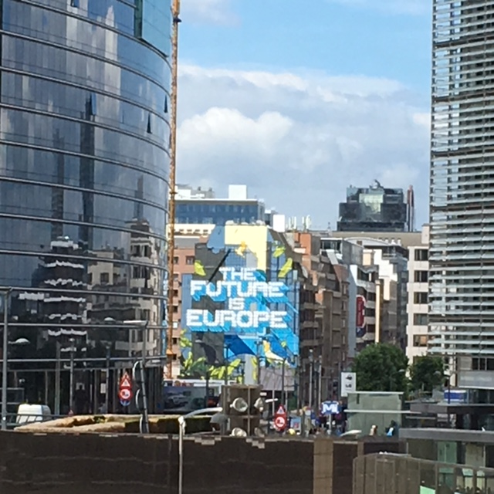
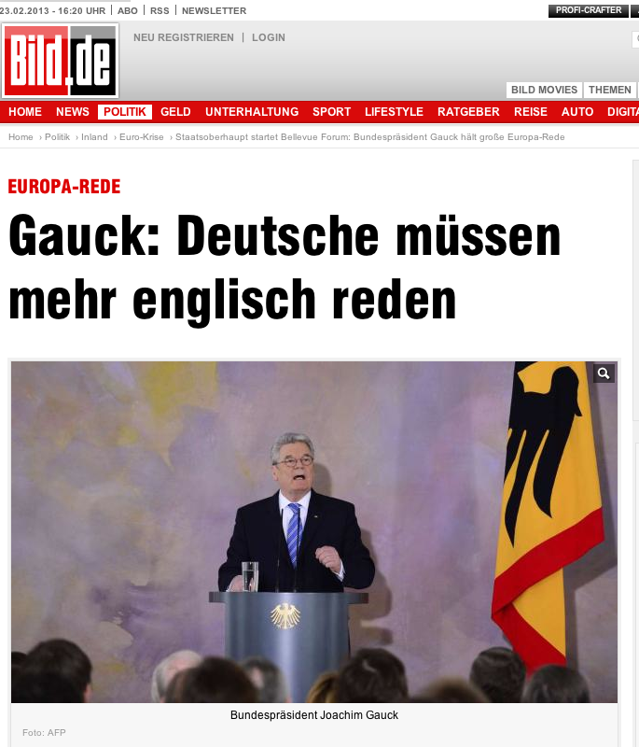
1. Lingua franca

Slide 12
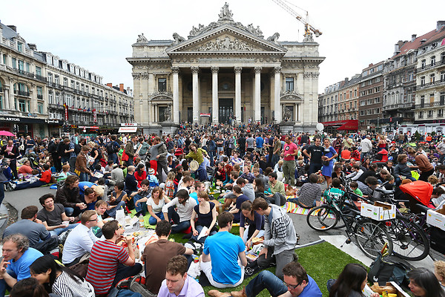
2. Reconquista degli spazi pubblici

Slide 13
3. Reddito di base

Slide 14
3. Reddito di base
3 modelli di protezione sociale
Assistenza sociale (Vives 1516/ Poor Laws 1598)
Assicurazione sociale (Condorcet1795/ Bismarck 1888)
Dividendo sociale (Charlier 1848/ Hammond 1982)

Slide 15
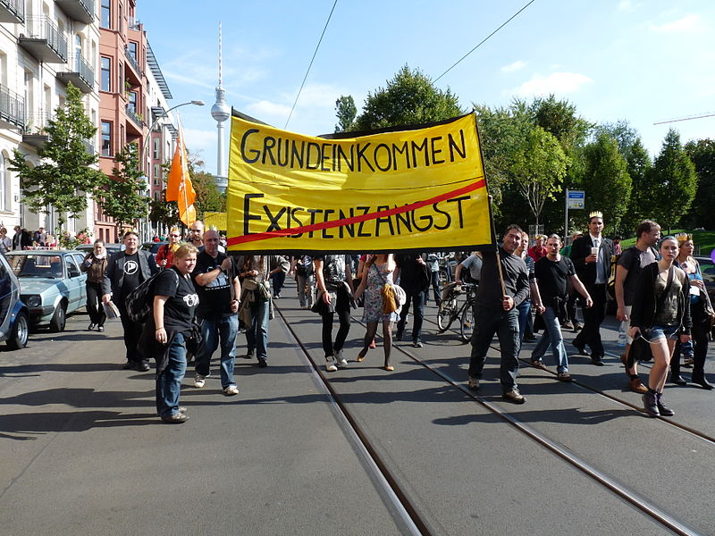
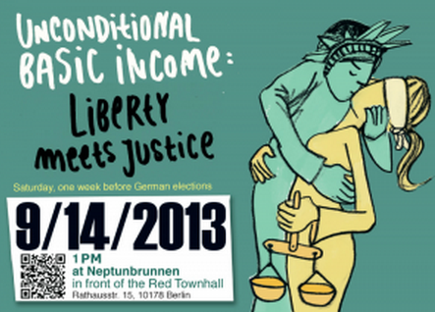
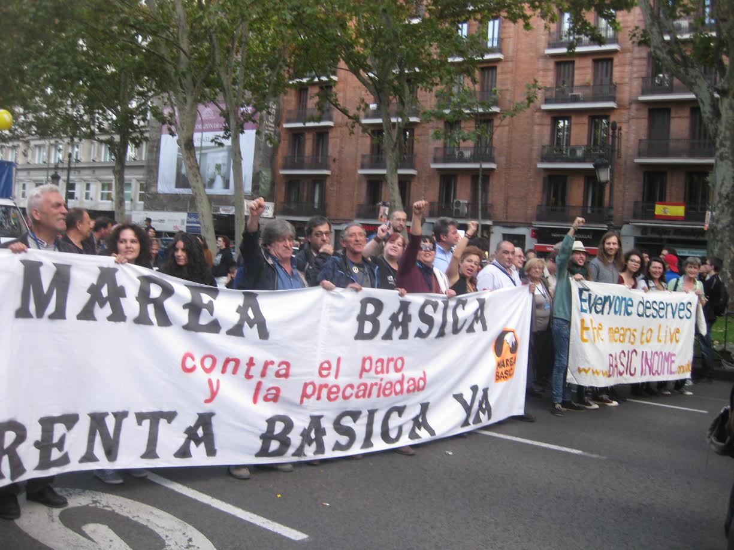
Eurodividendo

